Slide 2






Cluster from IGS-based method is as good as cluster in original paper from alignment-based method
or
Better?
Notes:
alpha, we pretty much the same cluster, put two sampels in the right place. better than the original paper
Using igs methods. Can get as good if not better cluster compared to . Two difference we think our clusteringmake smore sense.

Slide 3
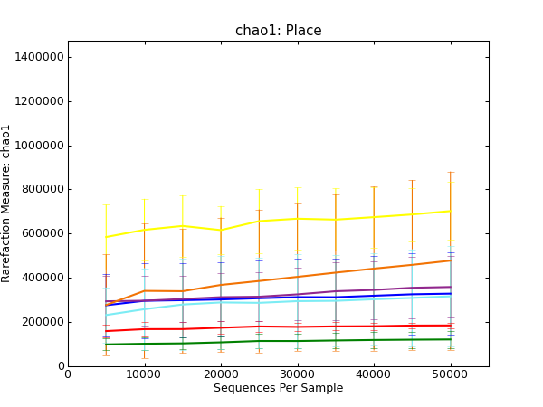
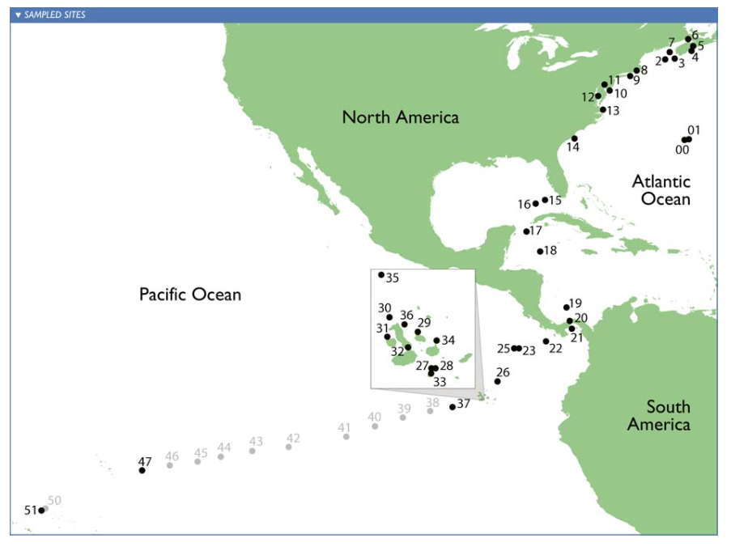
Sargasso
Open Ocean
Galapogas
Temperate -South
Estuary
Temperate - North
Notes:
alpha, this is new, abundant, look like more diverse tropical north temperate. o data we can get this conclusion using the method

Slide 4
K-mer counting(Chapter 3)
Streaming methods (Chapter 4)
Khmer
digital normalization
error analysis
Microbial diversity analysis (Chapter 5)
IGS method
Applications
seaworm symbiont

Slide 5
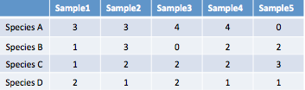
A typical pipeline of metagenome diversity analysis
Sample1
Reads
Assembly
Contigs
Sequencing
1000+ bp
100-150 bp
Abundance
Species
Binning
3x
1x
1x
2x
Species A
Species B
Mapping
Species C
Species D
Samples by species table
digital normalization

Slide 6
A typical pipeline of metagenome diversity analysis
Sample1
Reads
Assembly
Contigs
Sequencing
1000+ bp
100-150 bp
Abundance
Species
Binning
3x
1x
1x
2x
Species A
Species B
Mapping
Species C
Species D
Samples by species table
Error analysis

Slide 7
A typical pipeline of metagenome diversity analysis
Sample1
Reads
Assembly
Contigs
Sequencing
1000+ bp
100-150 bp
Abundance
IGS diversity analysis method
Binning
Species
3x
1x
1x
2x
Species A
Species B
Mapping
Species C
Species D
Samples by species table
A whole framework with potentials:
Alpha diversity ( richness, evenness) (Chao1, ACE estimators, etc.)
Beta diversity ( abundance-based, incidence-based)
Scalable, efficient:
Based on efficient k-mer counting
Using subsamples may be possible

Slide 8

Improve the pipeline
khmer
diginorm
Notes:
to real data set, big , and error, used several methods, to impveo, 1. filter short reads, do error, use ophtimal sfa, all require khmer , diginor, i participate. all the effort paid off. here.

Slide 9
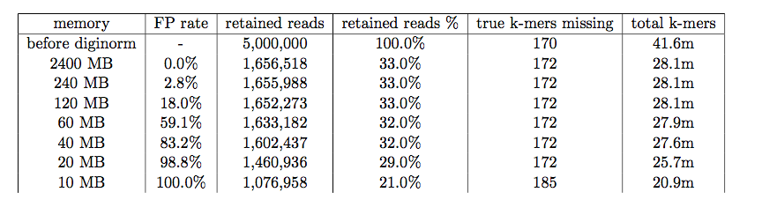
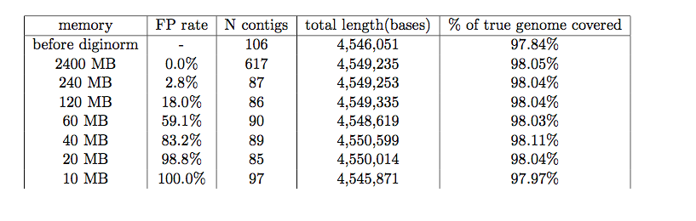
Digital normalization removes redundant reads and retains true information, with low memory usage

Slide 10
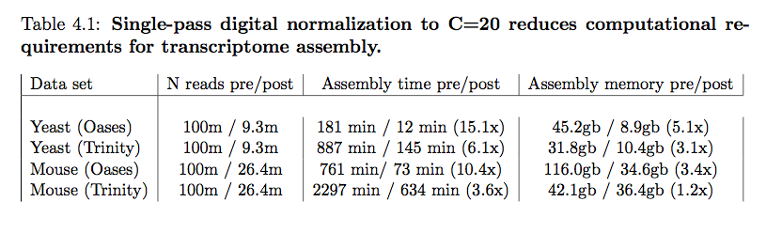
Digital normalization dramatically scales de novo assembly

Slide 11
From digital normalization to semi-streaming error analysis
^{for read in data:}
if coverage(read, table) < DESIRED:
^{add_read_to_graph(read, graph)}
^{analyze(read)}
for read in data: # first pass
if coverage(read, graph) < DESIRED:
^{add_read_to_graph(read, graph)}
^{save(read)}
^{else:}
^{analyze(read)}
for read in saved_reads: # second pass
if coverage(read, graph) >= DESIRED:
^{analyze(read)}

Slide 12
Semi-streaming approaches to analyze errors

Slide 13
Saturation curve of a real and a simulated E. coli read data set.

Slide 14
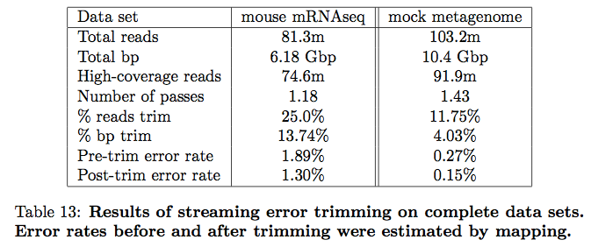
Efficient k-mer error trimming

Slide 15
Beta diversity compared to other method (COMMET)

